Slide 1

Title Layout
Rensildi Kalanxhi

Slide 2
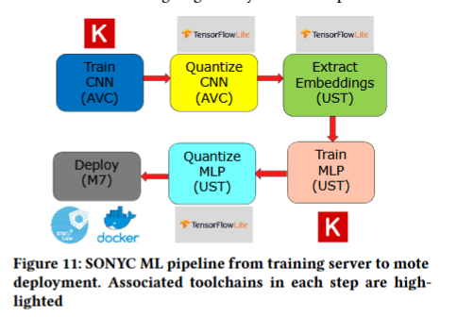
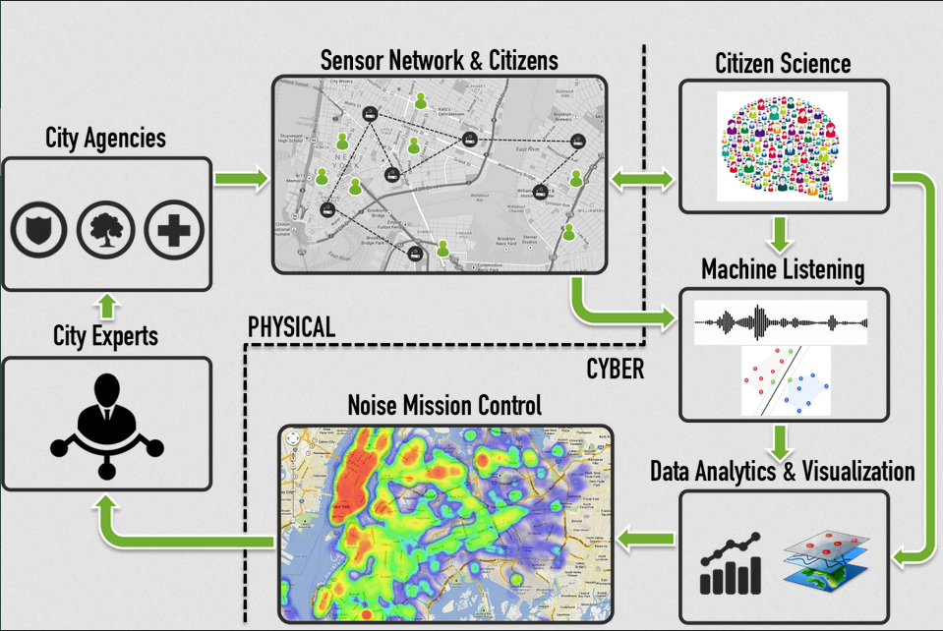
What is SONYC?
Sounds of New York City (SONYC)
Is a wireless sensor network
Goals
Monitor
Analyze
Reduce noise pollution
Notes:
Cyberphysical system, which includes

Slide 3
Why SONYC was created?
Noise Pollution
Short-Term Effects
Sleep disruption
Stress
Long-Term Effects
Cardiovascular disease
Hearing loss
Notes:
In New York, citizens can call 311 to make noise complains. If a certain volume of complaints occur in a specific location, an inspector is sent to investigate the noise.
Unfortunately the turnaround time is not fast enough to deal with most complaints and there is typically a four or five days delay in their response.

Slide 4
MKI (Mach 1) & MKII (Mach 2)
Old SONYC relied on MKI
Raspberry Pi-based devices
Required power & Wi-Fi infrastructure
Limited deployment to only ~3% of NYC
MKII motes (solved the previous problems/limitations)
Real-time noise classification
Solar powered (no power infrastructure)
LoRa networking replaced city Wi-Fi

Slide 5
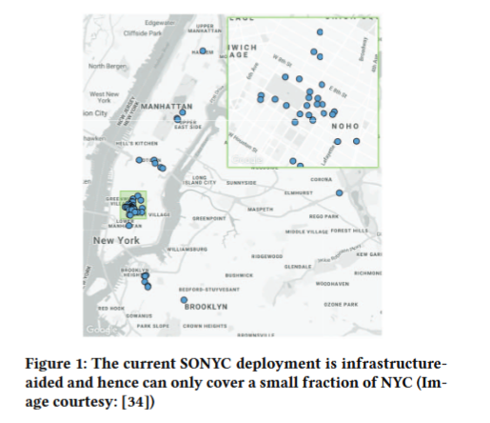
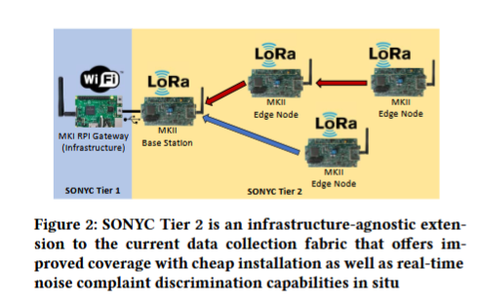

Slide 6
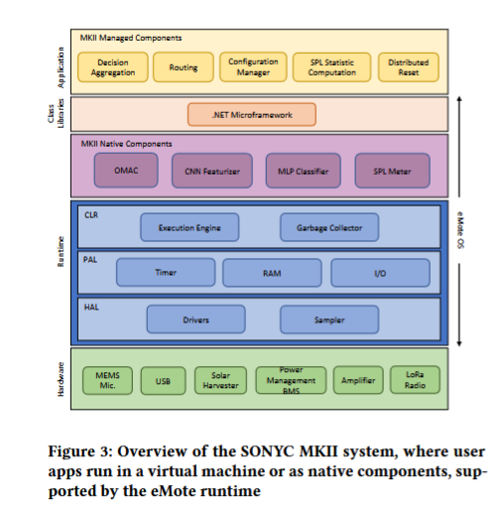
MKII 4 key hardware components
Digital 12S MEMS
Microphone for audio sensing.
LoRa radio chip (SX1276)
Long-range communication.
Solar-powered battery system
Energy management.
ARM Cortex-M7 microcontroller
Real-time processing & low power.
Notes:
MKII motes are designed for autonomous infrastructure-free deployment.
It uses:
5W solar panels and lithium-titanate (LTO) batteries for year-round power.
A software-defined Battery Management System (BMS) that optimizes charging and prevents failure.
Multi-hop LoRa networking, enabling devices to communicate over long distances.

Slide 7
Whats eMote runtime?
Efficient execution
ML models
Networking
System management
Integrates with SONYC infrastructure
Data transfer
Cloud-based visualization
Notes:
In New York, citizens can call 311 to make noise complains. If a certain volume of complaints occur in a specific location, an inspector is sent to investigate the noise.
Unfortunately the turnaround time is not fast enough to deal with most complaints and there is typically a four or five days delay in their response.

Slide 8
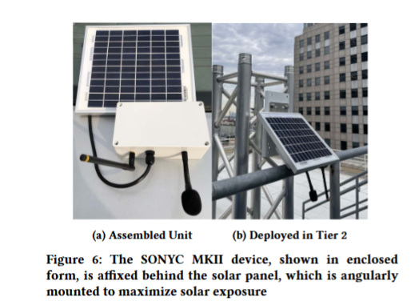
MKII
Notes:
In New York, citizens can call 311 to make noise complains. If a certain volume of complaints occur in a specific location, an inspector is sent to investigate the noise.
Unfortunately the turnaround time is not fast enough to deal with most complaints and there is typically a four or five days delay in their response.

Slide 9
SONYC-L3
CNN audio embedding model (mote-scale deployment)
Reducing input resolution
Lower sampling rate
Halving convolutional filters
Minimize activation memory
Applying 8-bit quantization
Reduce memory usage by 100x
Using Specialized Embedding Approximation (SEA)
Knowledge distillation
Training data reduced by 10x
Notes:
In New York, citizens can call 311 to make noise complains. If a certain volume of complaints occur in a specific location, an inspector is sent to investigate the noise.
Unfortunately the turnaround time is not fast enough to deal with most complaints and there is typically a four or five days delay in their response.

Slide 10
SONYC-L3 evaluation
Superior accuracy to larger models while requiring ~1MB memory
L3-Net
EdgeL3
Notes:
In New York, citizens can call 311 to make noise complains. If a certain volume of complaints occur in a specific location, an inspector is sent to investigate the noise.
Unfortunately the turnaround time is not fast enough to deal with most complaints and there is typically a four or five days delay in their response.

Slide 11
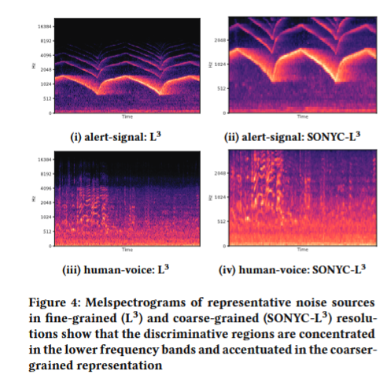
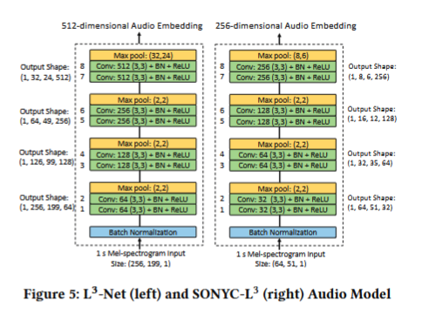
SONYC-L3 vs L3-Net & L3
Comparison of melspectrograms
SONYC-L3 is a reduced version of L3-NET with CNN optimization layers for low-power execution
Notes:
In New York, citizens can call 311 to make noise complains. If a certain volume of complaints occur in a specific location, an inspector is sent to investigate the noise.
Unfortunately the turnaround time is not fast enough to deal with most complaints and there is typically a four or five days delay in their response.

Slide 12
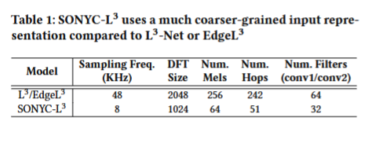
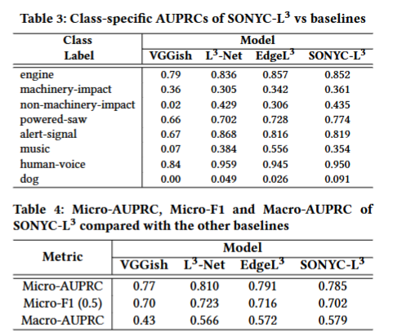
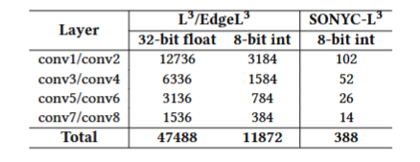
SONYC-L3 vs L3-Net & L3
Notes:
SONYC-L3 coarser input representation vs L3/EdgeL3, reduing frequency bins and filters for efficiency.
SONYC-L3’s activation memory is 100x lower than L3-Net, making it feasible for embedded deployment.
Per-class AUPRC comparison, showing SONYC-L3 outperforms L3-Net on most urban sound categories
Micro and macro-AUPRC scores, confirming SONYC-L# achieves high accuracy despite compressions.

Slide 13
SONYC-L3 evaluation
Superior accuracy to larger models while requiring ~1MB memory
L3-Net
EdgeL3

Slide 14
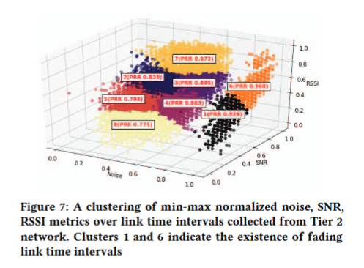
Management of External Interference
902-928 MHz ISM band in urban areas.
High interference
Signal fading
Solution:
Monitor noise, RSSI, and SNR in different frequencies.
Select most stable frequency (using passive and activate scanning)
Pre-node selection (Adapt dynamically locally)
Network-Wide Optimization (Adapt dynamically globally)
Notes:
Testing shows that MKII maintains high packet reception raters (PRR) by selecting optimal frequencies in real-time.
Figure-7: Clustering analysis reveals periods of links fading and interference across frequencies.

Slide 15
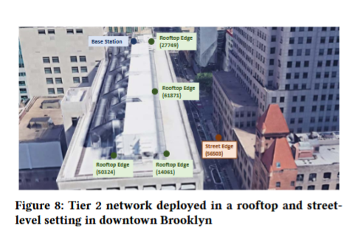
Results
MKII Tier 2 WSN was deployed in downtown Brooklyn
Rooftops & street level.
Demonstrated:
Stable long-term operation (with few outages).
Accurate classification of urban noise sources (engine, human voice, sirens)
Effective noise monitoring at different heights and urban conditions.

Slide 16
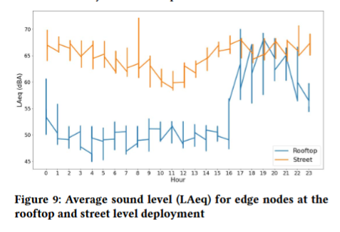
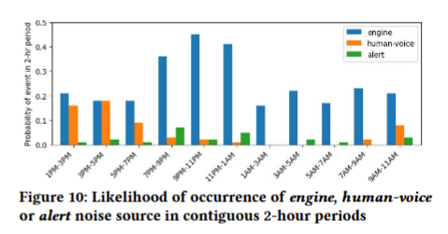
Results

Slide 17
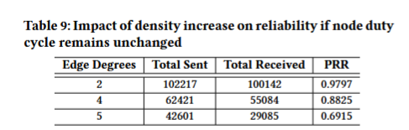
Results
Notes:
Impact of node density on reliability, demonstrating how self-interference increases with high node count.

Slide 18
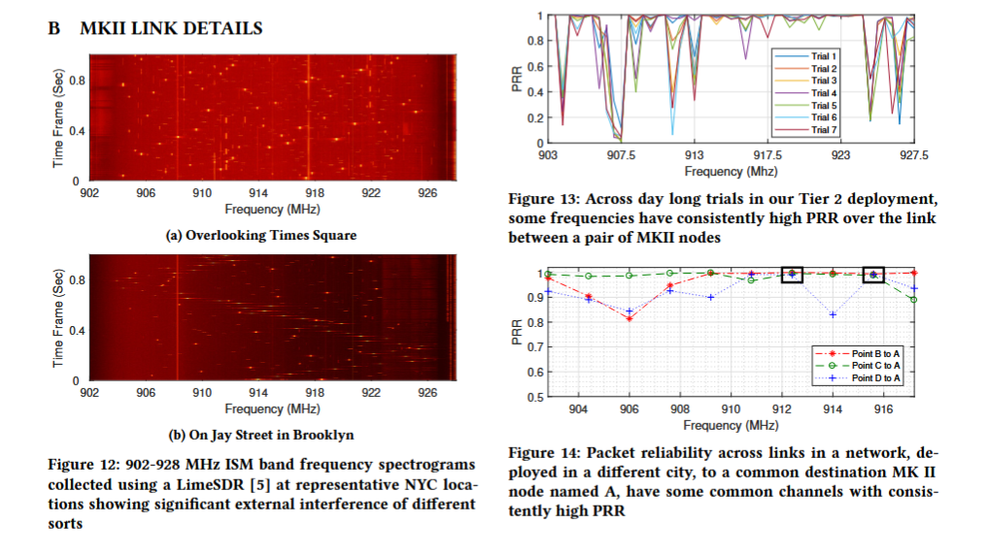
Appendices
Notes:
12. Spectrograms of ISM band frequencies showing real-world interference in NYC.
13 & 14. Packet Reception Rate (PRR) across frequencies, validating optimal frequency selection.

